Slide 1

Gesture Control 4DOF robot
NATIONAL INSTITUTE OF TECHNOLOGY KARNATAKA, SURATHKAL
MINI PROJECT
ME865: Robotics Mechanics and Control
SEMESTER 1 (2025-2026)
PRESENTED BY: Manash Pratim Ghosh (252MC013)
COURSE INSTRUCTOR: Dr Mervin Joe Thomas

Slide 2
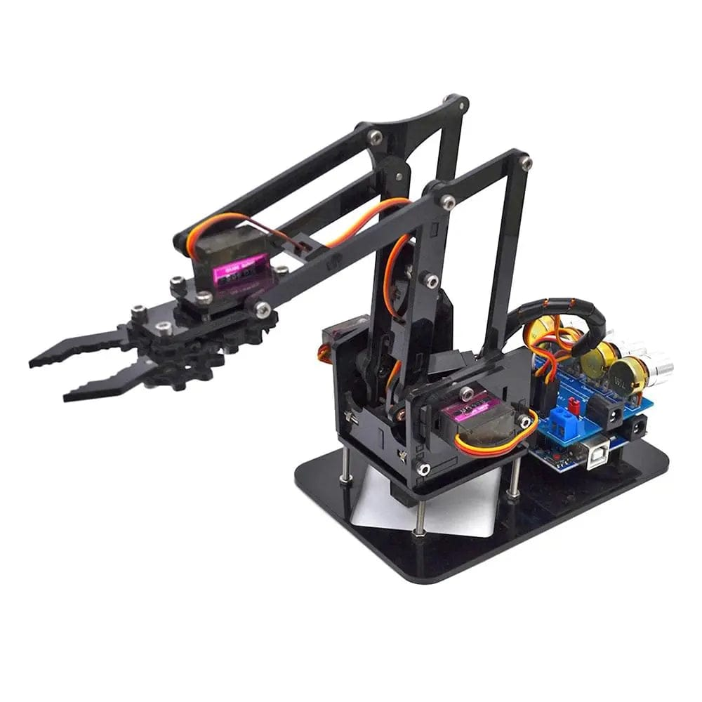
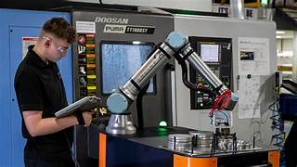
Gesture Control Robot
Flexible, user-friendly robotic arm designed to safely and directly work alongside humans in a shared workspace across numerous industrial and medical applications.

Slide 3
Project Overview
Motion
MPU6050
The goal is to build a 4-DOF gesture-controlled robotic arm that can detect motion and perform various operations.
ESP32 Microcontroller
Servo Motors
Platform

Slide 4
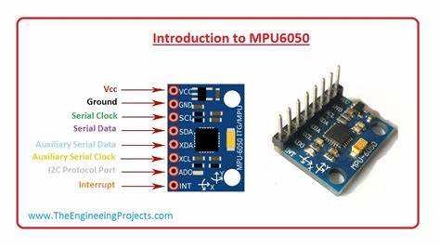
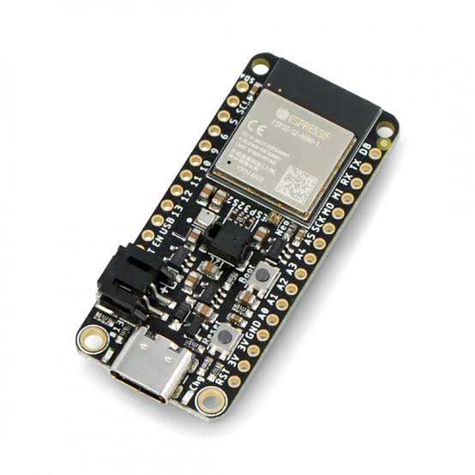
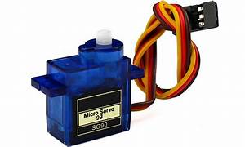
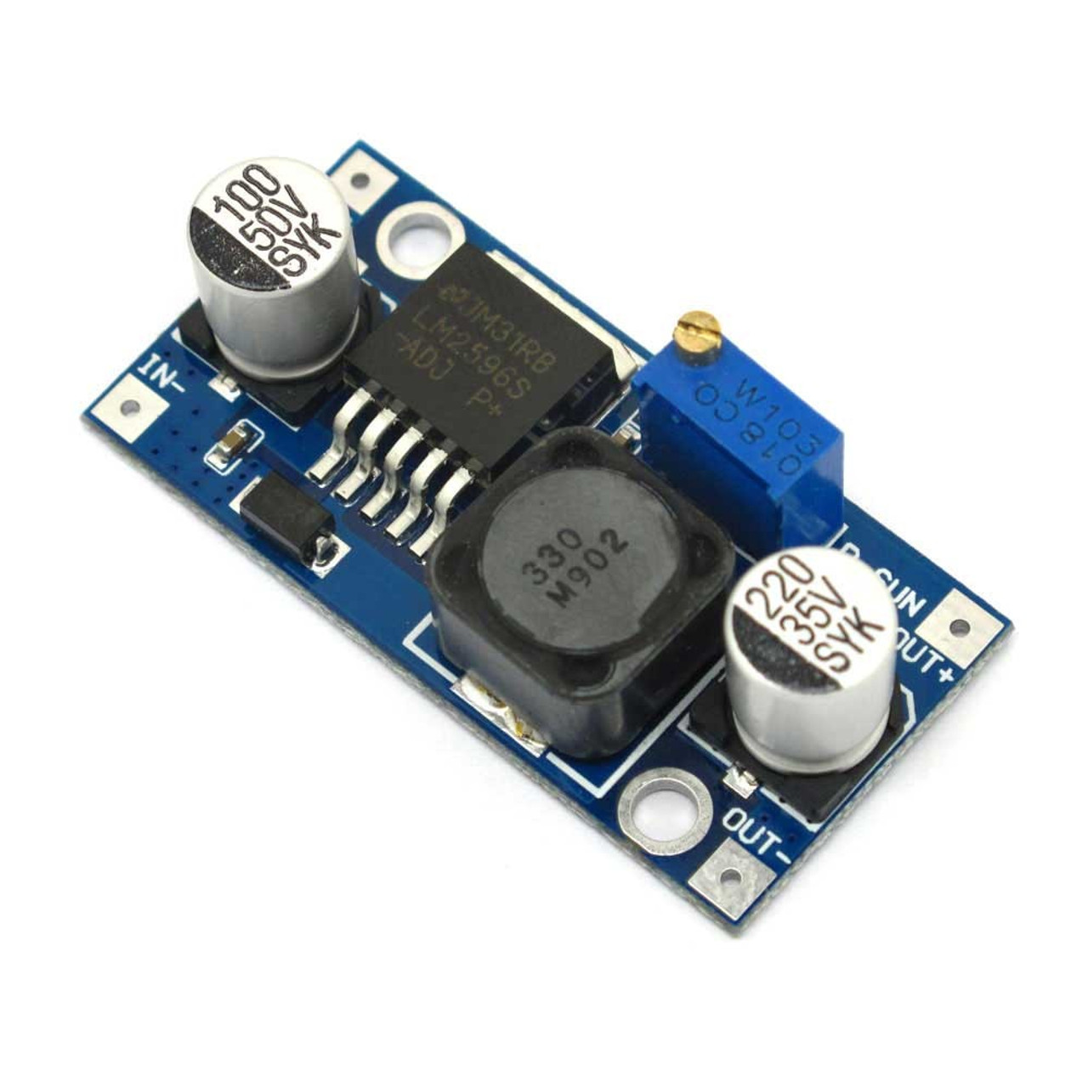
Components Used
ESP32 Microcontroller
Acts as the brain of the system that processes data from sensors.
MPU6050 Sensor (3.3 to 5V)
Detects tilt and movement using a gyroscope and accelerometer.
Measurement Range (Accelerometer) ±2g, ±4g, ±8g, ±16g (programmable)
Measurement Range (Gyroscope) ±2g, ±4g, ±8g, ±16g (programmable)
SG90 Servo Motors (5 to 6V)
Rotate the platform with good torque and speed.
Rotation Range – 0 to 180*
Stall Torque – 1.2 – 1.8 kg-cm
Control Signal – Pulse width modulation (PWM)
Acrylic Frame
A Lightweight structure that holds all the parts.
Power Supply & Motor Drivers
Provide stable power and voltage to all the motors.
MPU 6050
ESP32 Microcontroller
SG90 Servo Motor
Buck Converter

Slide 5
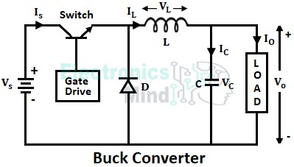
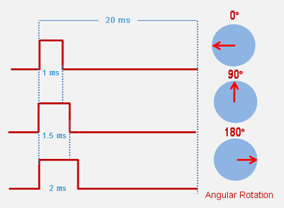
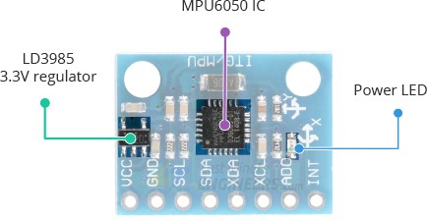

Slide 6
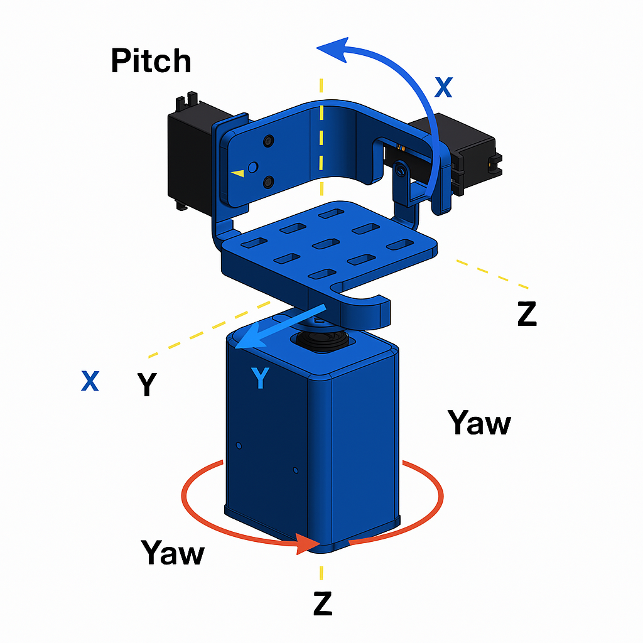
Robot Workspace
Degrees of Freedom
4 DOF: RRR
Semi-Spherical workspace
Each axis controlled by 4 SG90 servos
How It Moves
Yaw: Base rotates the whole unit
Pitch: Front/back tilt of platform
Roll: Side tilt using side servos
ROLL

Slide 7
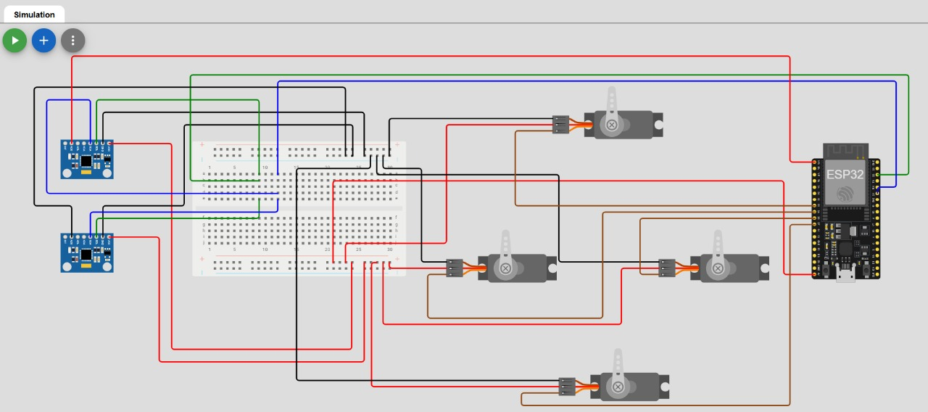

Slide 8
Robot Workspace
Axis/part | Range | Details
Height (Z-axis) | ~ 210 mm | Total height from base to top platform
Width (Y-axis) | ~460 mm | Combined servo arms (230 +230 mm)
Depth (X-axis) | ~200 mm | Platform base span
Yaw Rotation | 0° – 180° | Base swivel via servo
Pitch Rotation | 0° – 180° | Front/back tilt of upper platform
Roll Rotation | 0° – 180° | Side-to-side balancing movement

Slide 9
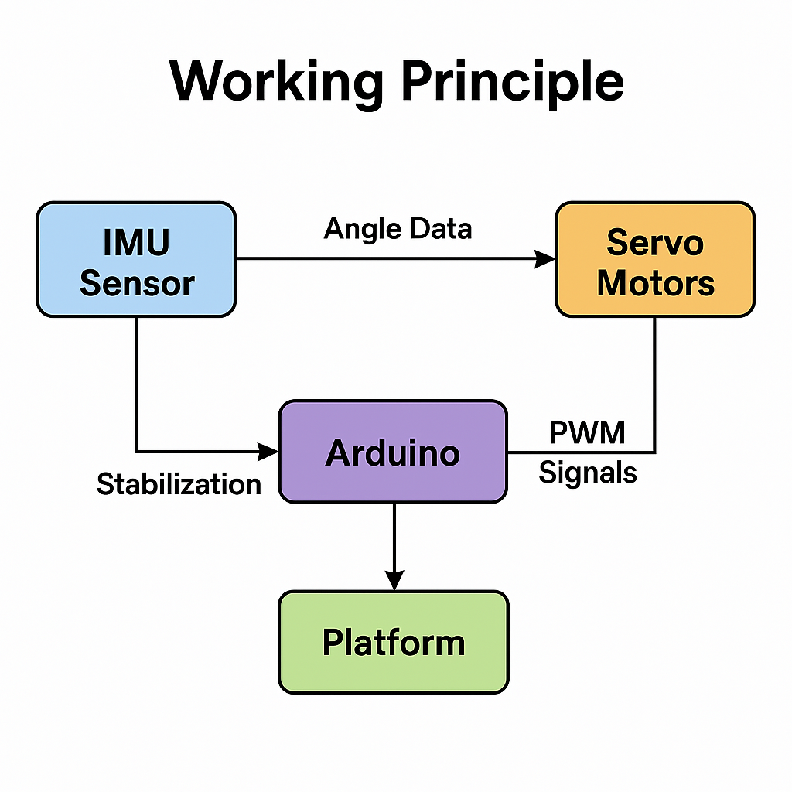
Working Principle
The MPU6050 IMU sensor detects angular motion (pitch, roll, yaw) of the platform.
It sends this orientation data to the ESP32 Microcontroller via I2C communication.
Based on this, it generates PWM signals to control the SG90 servo motors.
The servos rotate accordingly to the orientation of the MPU6050 sensors.
ESP32

Slide 10
Control Logic and Signal FLow

Slide 11
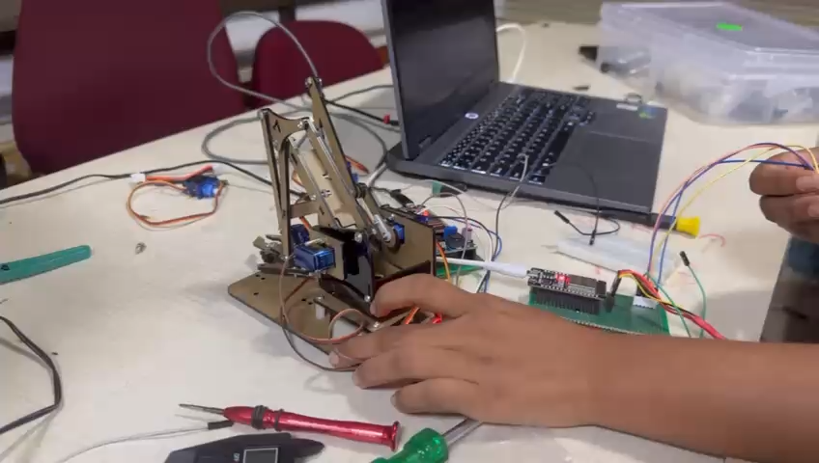
Testing
Testing Focus:
Simulate motion in all 3 axes (Pitch, Roll, Yaw)
Live tracking of angle data from MPU6050

Slide 12
Applications
Pick-and-Place Operations:
These arms are widely used for swiftly and accurately picking up objects from one location and placing them in another, such as on an assembly line.
Precision Work:
They can be guided for tasks requiring high precision, such as:​Welding​, Drilling,​Painting​, and Assembly of small components​
Service Robots:
Controlling robotic "nurses" or assistants in a hospital setting to handle supplies, especially in sterile or infectious environments
Reduced Operator Strain:
By using the robot to handle heavy goods, operators can minimize physical labor and the risk of injury associated with repetitive lifting.​

Slide 13


Challenges and Future Scope
Challenges:
Minimizing vibrations and mechanical backlash.
Accurate sensor calibration in changing conditions.
Future Scope :
Advancements in Control Technology (The Shift to Vision).
Enhanced Collaboration and Flexibility in Industry

Slide 14
Summary
Objective: Design a 4 DOF Gesture control robotic arm
Components Used: ESP32 Microcontroller, MPU6050, SG90 Servos
Working: works by using sensors (like IMU ) to capture human hand movement, wirelessly transmitting the processed data as commands, and using servo motors to precisely mimic that movement.
Outcome: Smooth, responsive platform ideal for real-world motion control tasks

Slide 15

Conclusion
Successfully built a 4 DOF gesture control robotic arm
Implemented real-time motion control using MPU6050 & ESP32
Gained hands-on experience in Sensors and Actuators
Opens scope for advanced applications in robotics and automation

